Slide 1
Scalable and Emerging Information System Techniques
Chapter-8
KEC, Dhapakhel

Slide 2
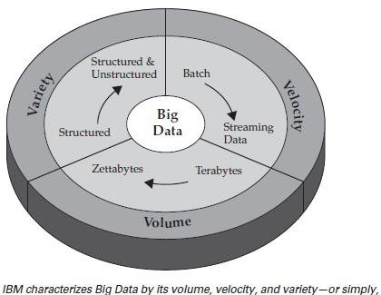
Big Data
Big Data applies to information that can’t be processed or analyzed using traditional processes or tools.

Slide 3
Techniques for Voluminous Data
Cloud Computing is an efficient method to balance between dealing with voluminous data and keeping costs competitive, is designed to deliver IT services consumable on demand, is scalable as per user need and uses a pay-per-use model.
Business houses are progressively turn towards retaining core competencies, and shedding the non-core competencies for on-demand technology, business innovation and savings.

Slide 4
Cloud Computing
Cloud computing consists of hardware and software resources made available on the internet as managed third-party services.
These services typically provide access to advanced software applications and high-end networks of server computers.
Cloud computing is comparable to grid computing, a type of computing where unused processing cycles of all computers in a network are connect to solve problems too intensive for any stand-alone machine.

Slide 5
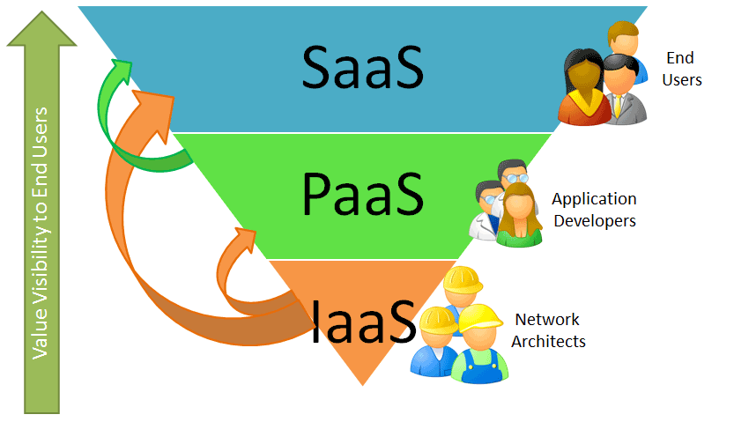
Cloud Computing Layers

Slide 6
Types of Cloud Computing
SaaS (Software as a Service): This is the idea of providing a given application to multiple tenants, typically using the browser which supports business applications of host and delivery type as a service. End Customers for instance Google Doc, Myspace.com
Common features of SaaS:
a) User applications run on cloud infrastructure
b) Accessible by users through web browser
c) Suitable for CRM (Customer Resource Management) applications
d) Supports multi-tenant environment
Notes:
Web-based cloud services. These services let you exploit certain web service functionality, rather than using fully developed applications. For example, it might include an API for Google Maps, or for a service such as one involving payroll or credit card processing.
Managed services. This is perhaps the oldest iteration of cloud solutions. In this scenario, a cloud provider utilizes an application rather than end-users. So, for example, this might include anti-spam services, or even application monitoring services.
Service commerce. These types of cloud solutions are a mix of SaaS and managed services. They provide a hub of services which the end-user interacts with. Common implmentations include expense tracking, travel ordering, or even virtual assistant services.

Slide 7
Types of Cloud Computing
PaaS (Platform as a Service): This is a variant of SaaS. You run your own applications but you do it on the cloud provider’s infrastructure. Provides a comprehensive stack for developers to create Cloud-ready business applications.
Developers for instance Force.com, Google App Engine, Azure and Salesforce.com etc
Features of PaaS are:
a) Supports web-service standards
b) Dynamically scalable as per demand
c) Supports multi-tenant environment

Slide 8
Types of Cloud Computing
IaaS (Infrastructure as a Service): These are virtual storage and server options that organizations can access on demand, even allowing the creation of a virtual data center. Delivers computing hardware like Servers, Network, Storage, etc. For instance Rackspace.com, GoGrid.com etc.
Typical features are:
a)Users use resources but have no control of underlying cloud infrastructure
b)Users pay for what they use
c)Flexible scalable infrastructure without extensive pre-planning

Slide 9
Benefit of Cloud Computing
Reduced Cost : Cloud technology is paid incrementally, saving organizations money.
Increased Storage: Organizations can store more data than on private computer systems.
Highly Automated: No longer do IT personnel need to worry about keeping software up to date.
Flexibility: Cloud computing offers much more flexibility than past computing methods.
More Mobility: Employees can access information wherever they are, rather than having to remain at their desks.
Allows IT to Shift Focus: No longer having to worry about constant server updates and other computing issues, government organizations will be free to concentrate on innovation.

Slide 10
MapReduce
MapReduce is a software framework that allows developers to write programs that process massive amounts of unstructured data in parallel across a distributed cluster of processors or stand-alone computers.
It was developed at Google for indexing Web pages and replaced their original indexing algorithms and heuristics in 2004.
Notes:
MapReduce is for huge data sets that have to be indexed, categorized, sorted, culled, analyzed, etc.

Slide 11
MapReduce and Hadoop Systems
MapReduce is the heart of Hadoop.
MapReduce allows data to be distributed across a large cluster, and can distribute out tasks across the data set to work on pieces of it independently, and in parallel.
This allows big data to be processed in relatively little time.
Apache has produced an open source MapReduce platform called Hadoop.
Notes:
MapReduce is the heart of Hadoop®. It is this programming paradigm that allows for massive scalability across hundreds or thousands of servers in a Hadoop cluster. The MapReduce concept is fairly simple to understand for those who are familiar with clustered scale-out data processing solutions.

Slide 12
Framework is divided into two parts
Map, a function that parcels out work to different nodes in the distributed cluster.
Reduce, another function that collates the work and resolves the results into a single value.
The MapReduce framework is fault-tolerant because each node in the cluster is expected to report back periodically with completed work and status updates. If a node remains silent for longer than the expected interval, a master node makes note and re-assigns the work to other nodes.

Slide 13
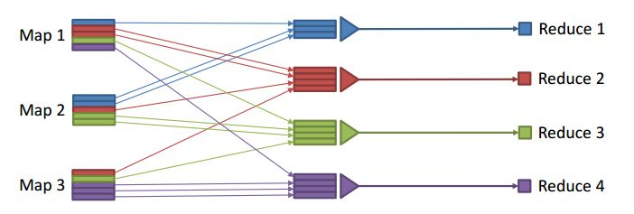
MapReduce Interaction
Map functions create a user-defined “index” from source data
• Reduce functions compute grouped aggregates based on index
• Flexible framework
users can cast raw original data in any model that they need
wide range of tasks can be expressed in this simple framework

Slide 14
Hadoop System
Developed by Apache as an open source distributed MapReduce platform, based off of Google's MapReduce.
Runs on a Java architecture framework that supports the processing of large data sets in a distributed computing environment.
Hadoop allows businesses to process large amounts of data quickly by distributing the work across several nodes.
Good for Big data sets and on large cluster.

Slide 15
Hadoop - A Key Business Tool
Hadoop System is used by Large Content-Distribution Companies, such as...
Yahoo
Hadoop is used for many of their tasks, and over 25,000 computers are running Hadoop.
Amazon
Hadoop is good for Amazon, they have lots of product data, as well as user-generated content to index, and make searchable.
New York Times
Hadoop is used to perform large-scale image conversions of public domain articles.

Slide 16
Hadoop - A Key Business Tool
Used by Non-Content-Distribution Companies, such as
Facebook
eHarmony
Other early adopters include anyone with big data:
medical records
tax records
network traffic
large quantities of data
Wherever there is a lot of data, a Hadoop cluster can generally process it relatively quickly.

Slide 17
Data Management in the Cloud
• Data management applications are potential candidates for
deployment in the cloud
– Industry: enterprise database system have significant up-front cost that includes both hardware and software costs
– Academia: manage, process and share mass-produced data in the cloud
• Many “Cloud Killer Apps” are in fact data-intensive
– Batch Processing as with MapReduce
– Online Transaction Processing (OLTP) as in automated business applications
– Offline Analytical Processing (OLAP) as in data mining or machine learning
Notes:
Organizations should evaluate how their storage resources can most effectively be used in the cloud.
Before they can do that, it's best to categorize the model of cloud computing in the organization.
Three types of cloud computing dominate the landscape:
private (in which a company hosts, owns and manages its own cloud infrastructure),
public (in which a third party owns and manages the infrastructure) and
hybrid (in which the public and private models are combined).
In hybrid models, the public cloud often acts as an overflow facility for the private cloud or is used to satisfy other application needs such as off-site information protection. The underlying characteristic of each is that cloud services need to be available and reliable to users, while effectively optimizing resources and providing a pay-as-you-go delivery model.

Slide 18
Data Management in the cloud
A database system must implement for it to run well in the cloud, in potential database applications to consider for cloud deployment.
Data management applications are best suited for deployment on top of cloud computing infrastructure.
Data management is the proper management of a data resource for an organization. Data management consists of a set of theories, concepts, principles, and techniques for properly managing data.
The primary objective is to support the business information as needs of the organization.
Notes:
The new CDMS is available in three versions: The free option has two hosts; 4 gigabytes of storage space; unlimited database; and limited deployment.^{[13]}
The Developer version is also free and has all of the features of the Pro version, but does not have deployment options.^{[14]}
The Pro version can run on two or more host machines, either virtually or physically.^{[15]}
It provides storage space options for up to multi-petabytes, and has unlimited deployment.
The starting price for the Pro version is $1,200 per year.^{[13]} The Pro version license cost depends on the number of hosts and the size of the databases.^{[15]}

Slide 19
Data Management in Cloud
There are three characteristics of a cloud computing environment.
Compute power is elastic, but only if workload is parallelizable.
Data is stored at untrusted host.
Data is replicated, often across large geographic distances
Notes:
Specific country laws: Laws governing data differ across geographic boundaries. Your own country's legal protections may not apply if your data is located outside of the country. A foreign government may be able to access your data or keep you from fully controlling your data when you need it.
Data transfer across country borders: A global company with subsidiaries or partners (or clients for that matter) in other countries may be concerned about cross-border transfer of data due to local laws. Virtualization makes this an especially tough problem because the cloud provider might not know where the data is at any particular moment.
Co-mingling of data: Even if your data is in a country that has laws you’re comfortable with, your data may be physically stored in a database along with data from other companies. This raises concerns about virus attacks or hackers trying to get at another company’s data.
Secondary data use: In public cloud situations, your data or metadata may be vulnerable to alternative or secondary uses by the cloud service provider.
Without proper controls or service level agreements, your data may be used for marketing purposes (and merged with data from other organizations for these alternative uses). The recent uproar about Facebook mining data from its network is an example.
The service provider may own any metadata it has created to help manage your data, lessening your ability to maintain control over your data.

Slide 20
Information Retrieval
Information retrieval is the activity of obtaining information resources relevant to an information need from a collection of information resources.
Searches can be based on metadata or on full-text indexing.
Automated information retrieval systems are used to reduce what has been called “information overload”.
Notes:
Information Overload is when you are trying to deal with more information than you are able to process to make sensible decisions. The result is either that you either delay making decisions, or that you make the wrong decisions.

Slide 21
Information Retrieval in the Cloud
IR user seeks actively information, pulling at it, by means of querying or browsing.
In tag querying, user enters one or more tags in the search box to obtain an ordered list of resources which were in relation with these tags.
When a user is scanning this list, the system also provide a list of related tags (i.e. tags with a high degree of co-occurrence with the original tag), allowing hypertext Browsing.

Slide 22
Information Retrieval System
Typically it refers to the automatic (rather than manual) retrieval of documents
Information Retrieval System (IRS)
Information Retrieval is a research-driven theoretical and experimental discipline
The focus is on different aspects of the information–seeking process, depending on the researcher’s background or interest:
Computer scientist – fast and accurate search engine
Librarian – organization and indexing of information
Cognitive scientist – the process in the searcher’s mind
Philosopher – Is this really relevant ?

Slide 23
The stages of IR
Indexed
and structured
information
Creation
Information
Indexing,
organizing
Retrieval
Searching
Browsing
Notes:
The documents are indexed in order to get descriptors that make sense to the system.

Slide 24
The formalized IR process
Real world
Anomalous state of knowledge
Collection of documents
Information need
Document representations
Query
Matching
Results
Notes:
Documents describe events from the real world; they are holders of information.
In order to be stored in a computer system in view of future retrieval, documents need to be processed and abstract document representations derived.
The user has an information need, not always explicit, derived either from an anomalous state of knowledge, or from an assigned task.
Queries need to be formulated in a language compatible to the system.
Following the analysis of the results produced by the matching process, the user’s state of knowledge may change, the information need may be clearer or more refined, or only partially satisfied.
More queries are generated and the results are examined, until the user is happy with the information gathered.

Slide 25
Stopwords / Stoplist
Function words do not bear useful information for IR
of, in, about, with, I, although, …
Stoplist: contain Stopwords, not to be used as index
Prepositions
Articles
Pronouns
Some adverbs and adjectives
Some frequent words (e.g. document)
The removal of stopwords usually improves IR effectiveness
A few “standard” stoplists are commonly used.

Slide 26
Stemming
Reason:
Different word forms may bear similar meaning (e.g. search, searching): create a “standard” representation for them
Stemming:
Removing some endings of word
computer
compute
computes
computing
computed
computation
comput

Slide 27
Link Analysis in Cloud Setup
The web is not just a collection of documents – its hyperlinks are important!
A link from page A to page B may indicate:
A is related to B, or
A is recommending, citing, voting for or endorsing B
Links are either
referential – click here and get back home, or
Informational – click here to get more detail
Links effect the ranking of web pages and thus have commercial value.

Slide 28
See More on Chapter 7 for Link Analysis
Thank you
Notes:
http://www.arunchinnachamy.com/web-tools/link-analysis-tool/ for experimental LINK ANALYSIS.

